Slide 1


165410003
Reno Faizal Mubaroch
Notes:
To change the image on this slide, select the picture and delete it. Then click the Pictures icon in the placeholder to insert your own image.

Slide 2
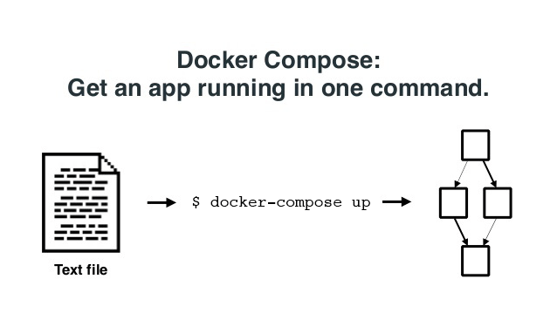
What is Docker Compose?
Compose is a tool for defining and running multi-container Docker applications.
docker-compose.yaml

Slide 3

A Brief History of Docker Compose
Fig
Originated from 3rd party utility called fig

Slide 4
Docker Compose Workflow
Define each service in a Dockerfile
Define the services and their relation to each other in the docker-compose.yml file
Use docker-compose up to start the system

Slide 5
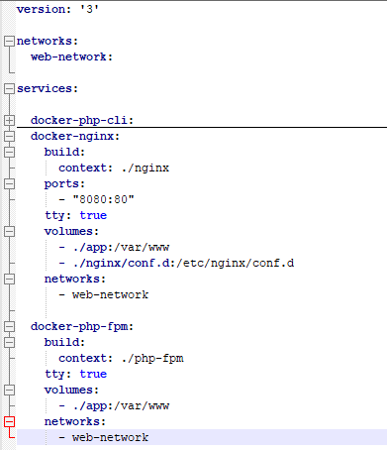
Docker Compose File Structure
Compose File Version
Docker Compose Network
Services
Service Name
Defining The Sevice

Slide 6
Docker Compose Advantage
Infrastructure as Code
Portability
Easy Setup
Open Source

Slide 7
Docker Compose Drawback
Development Speed

Slide 8
Thank You

